Slide 1
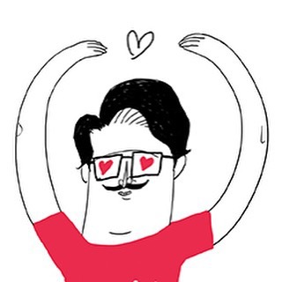
COSRX
TWITTER SENTIMENT ANALYSIS

Slide 2
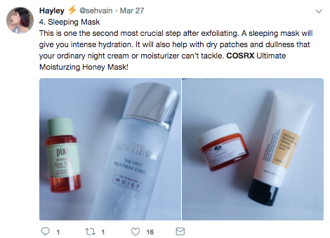
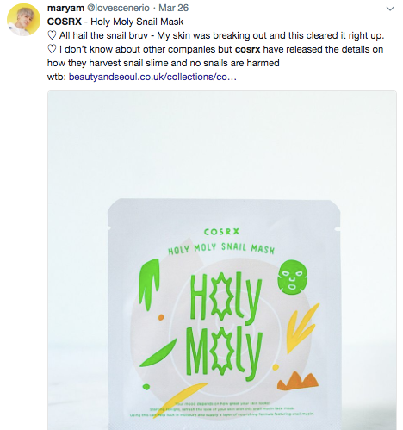
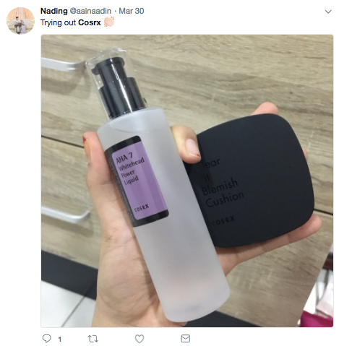
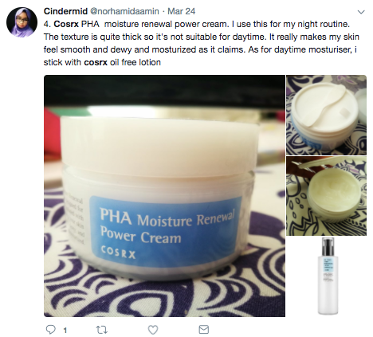
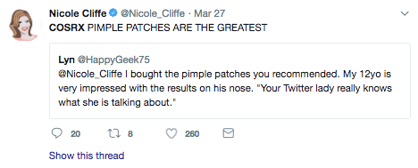
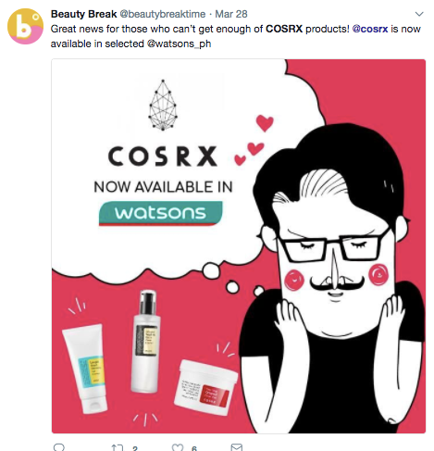
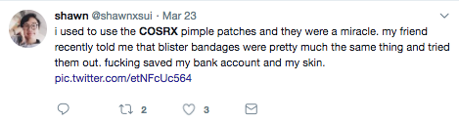


What is being said about COSRX on social media?
Twitter is a breeding ground for customer discussion. The beauty industry is not exempted from this.
This presentation aims to collect these tweets and present the findings in a more compact manner.

Slide 3

Tweet extraction
We extracted 1,100 tweets that mentioned COSRX in the English language.
Dates of tweet creation: February 14 to 24, 2018.
Tweet location is unavailable, as most Twitter users don’t turn on this setting.
Tweets were extracted using the twitteR package in R.

Slide 4
conversations at a glance
(Word clouds)

Slide 5
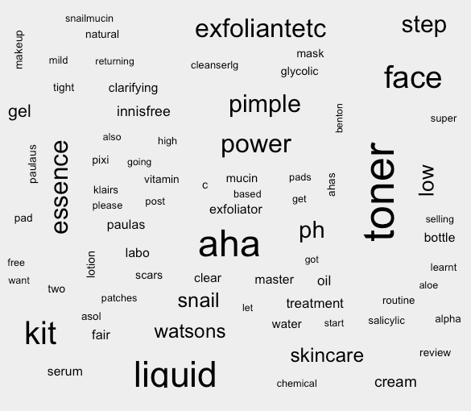

Slide 6

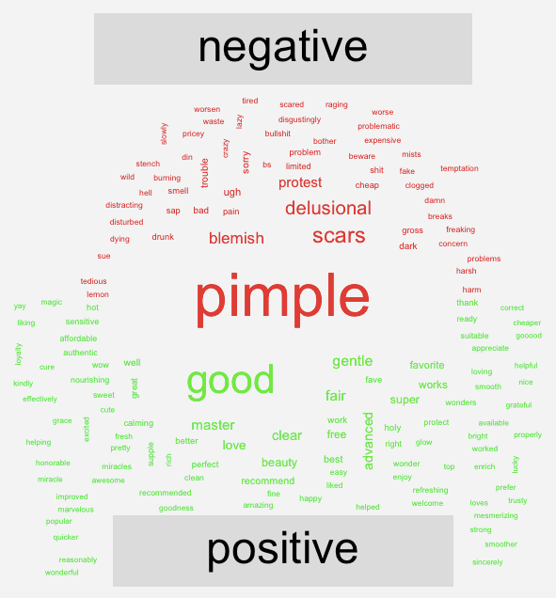

Slide 7
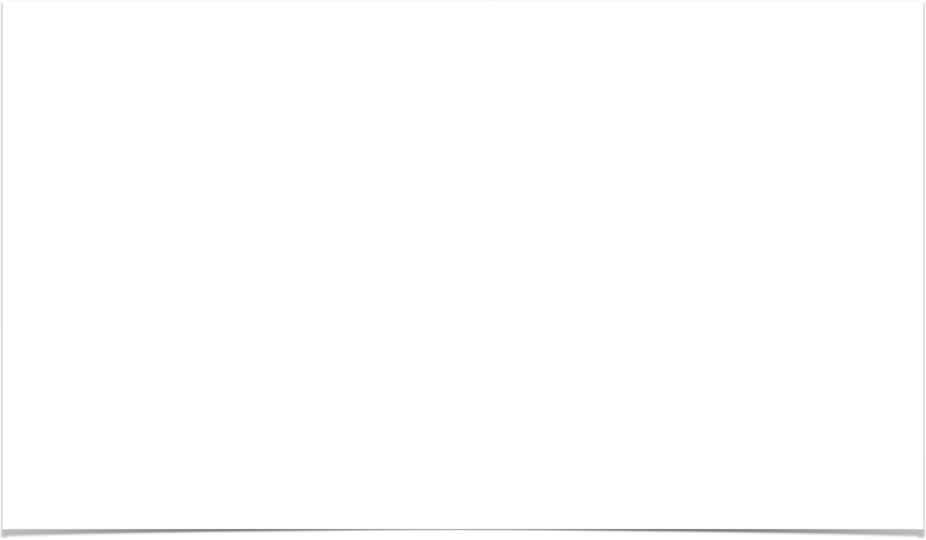
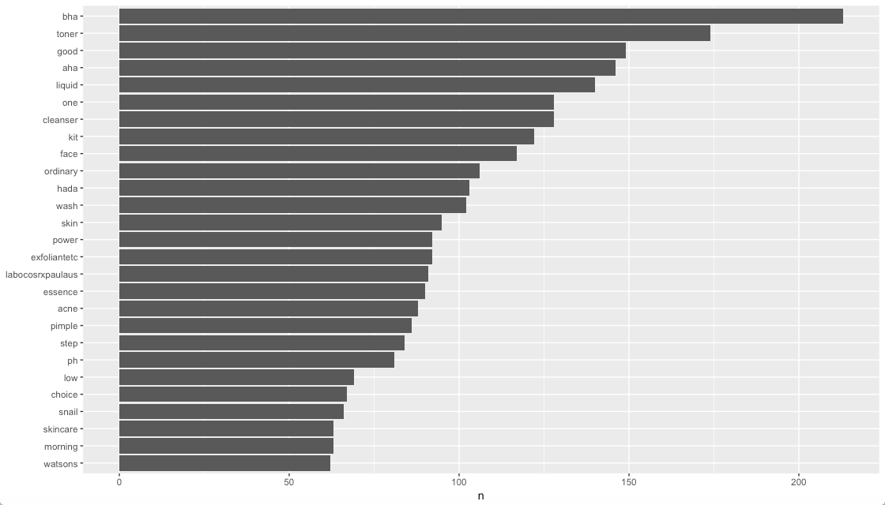
top words
(Overall)

Slide 8
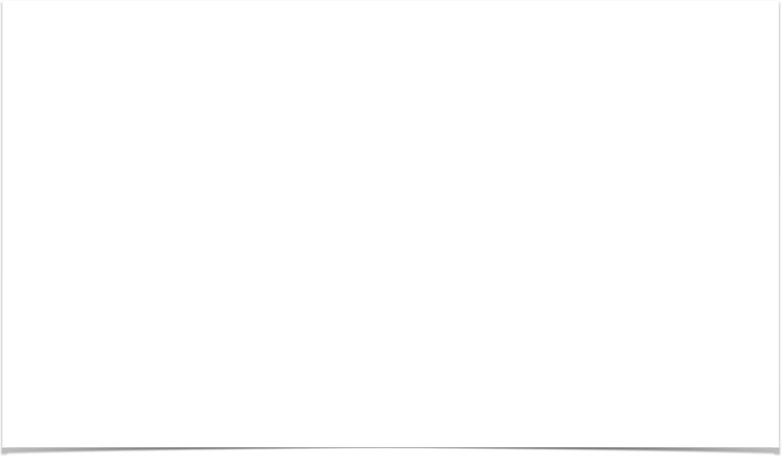
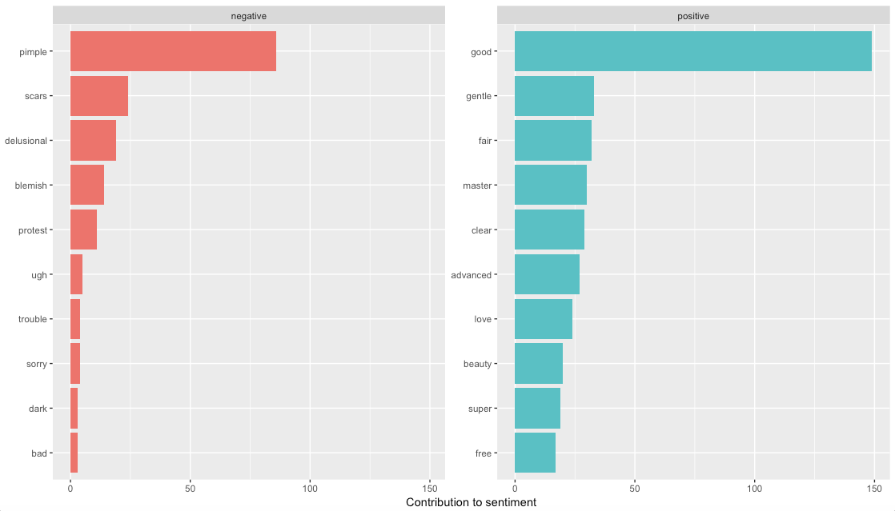
top words
Positive vs. Negative

Slide 9

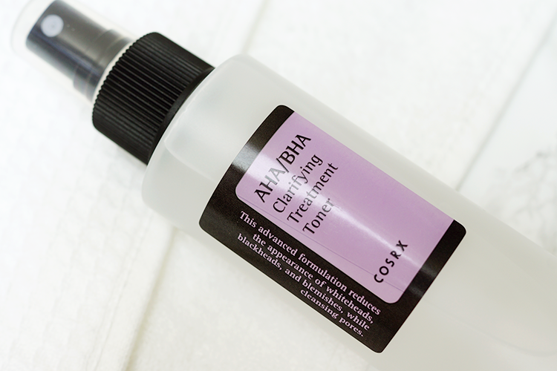
initial findings
AHA/BHA products emerged on top.
Pimples and scars were the main skin concern.
Top words mainly provide us with:
The most popular COSRX products
Top competing brands
Customer feedback, although this has a much lower frequency than the first two.

Slide 10
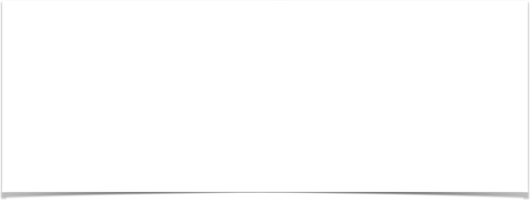
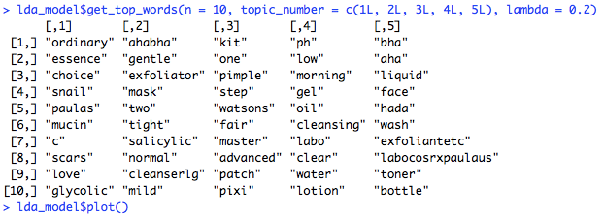
Topics of discussion
We run a Latent Dirichlet allocation (topic modelling) on the text.
This groups words that frequently appear together, or show a relation to one another.
This helps us figure out specific topics that Twitter users may have been talking about.
The goal: a more nuanced view of the discussion.

Slide 11

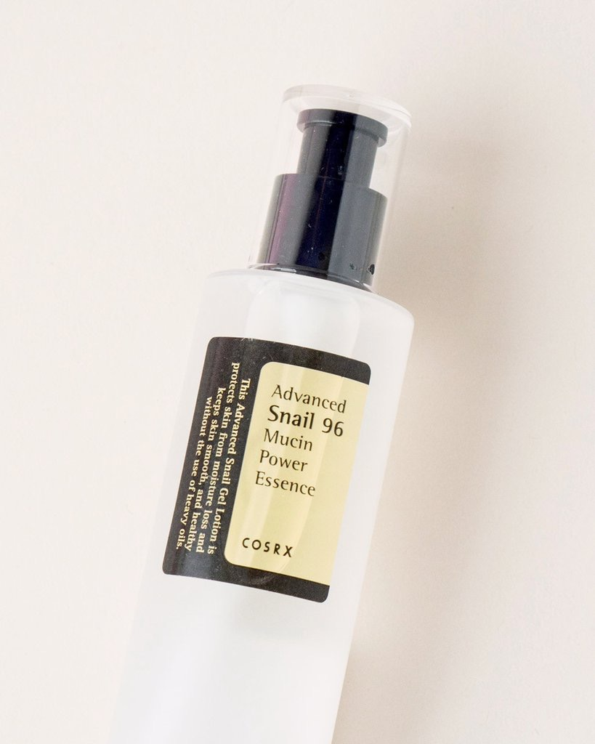
topic 1: brightening
Occurring terms:
Snail mucin
Exfoliants
Glycolic Acid
Vitamin C
Scars
Competing brands: The Ordinary and Paula’s Choice

Slide 12

TOPIC 2: CLARIFYING
Occurring terms:
AHA/BHA
Salicylic acid
Exfoliator
Gentle
Mild
Cleanser
Mask

Slide 13

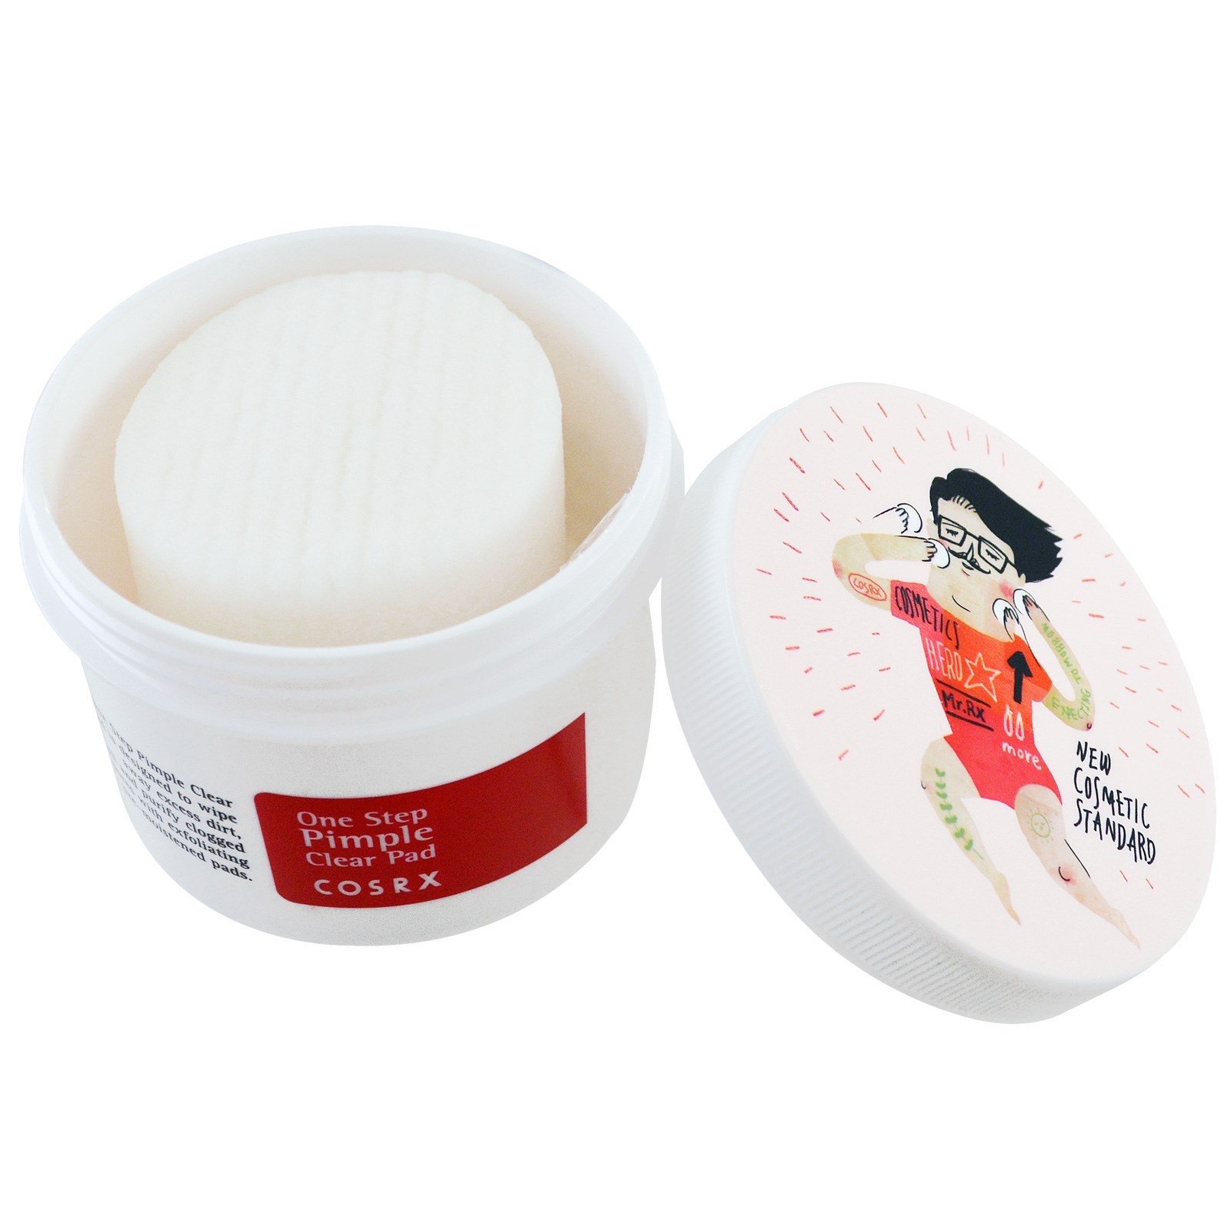
topic 3: quick fixes for pimples
Occurring terms:
One Step Pimple Clear Pads
One Step Pimple Clear Kit
Acne Pimple Master Patch
Clear Fit Master Patch
Watsons (drugstore)
Advanced Snail 96 Mucin Power Essence
Competing brand mentioned: Pixi

Slide 14

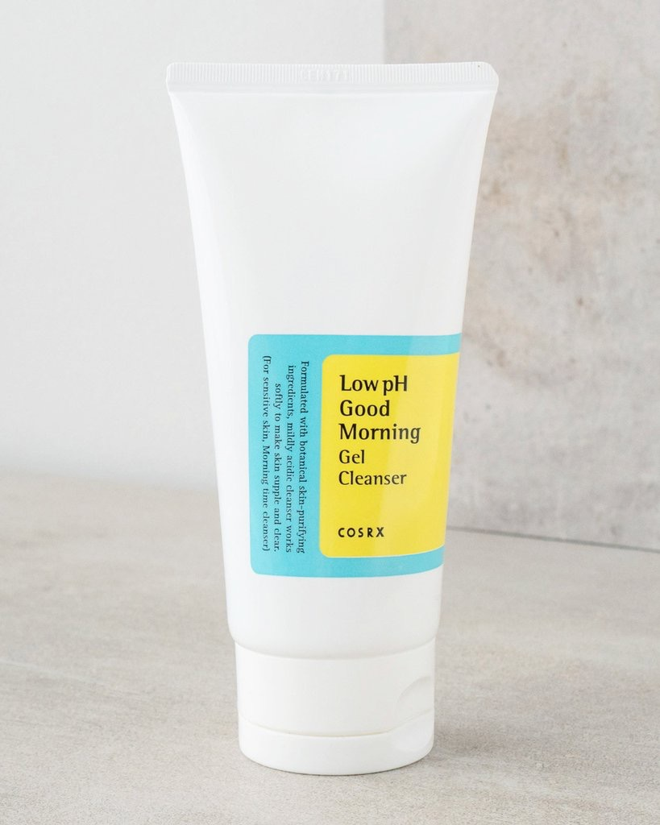
TOPIC 4: Cleansers
Occurring terms:
Low pH Good Morning Gel Cleanser
Hada Labo’s Cleansing Oil
Other words mentioned: clear, water, lotion (possibly COSRX’s Oil-Free Ultra-Moisturizing Lotion—a necessary step after cleansing)

Slide 15
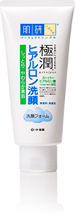
TOPIC 5
This topic is the least clear cut of the five.
Occurring terms:
Hada Labo Face Wash
BHA liquid
AHA liquid
Exfoliant
Toner
Additional competing brand mentioned: Paula’s Choice

Slide 16

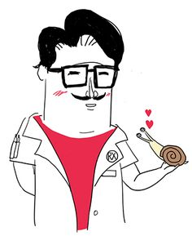
FINDINGS

Slide 17

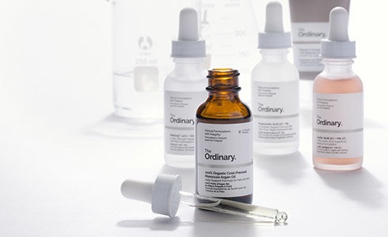
Top competing brands
The Ordinary (Canada)
Hada Labo (Japan)
Paula’s Choice (US)
Innisfree (Korea)
Pixi (UK)
Benton (Korea)
Drunk Elephant (US)
Dear, Klairs (Korea)

Slide 18

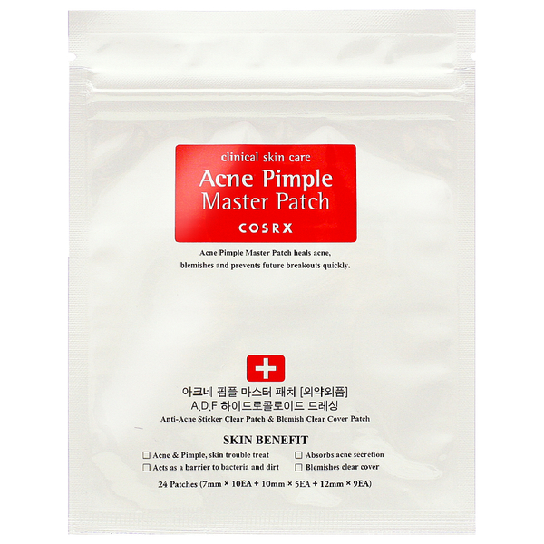
TOP SKIN PROBLEMS
Pimples
Scars
Blemishes
Blackheads
Dark spots
Clogged pores

Slide 19

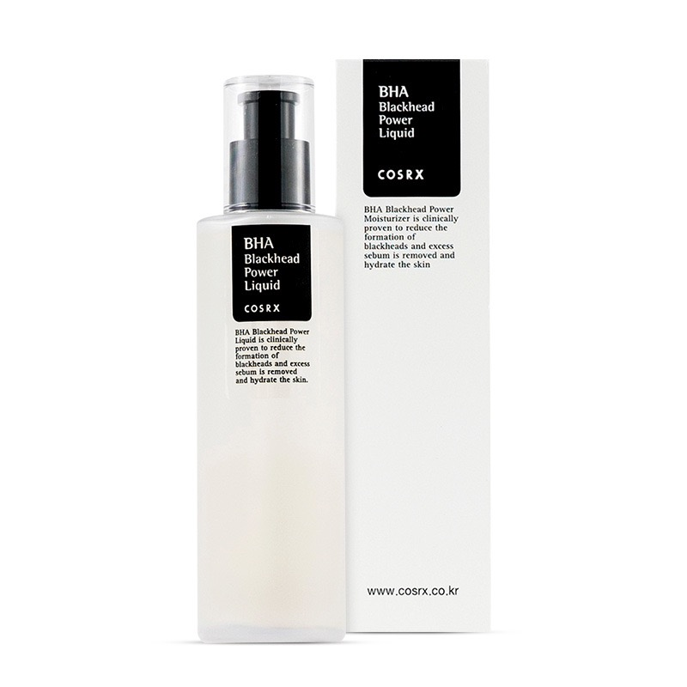
top skincare substances
BHA
AHA
Snail mucin
Glycolic acid
Vitamin C
Aloe
Birch sap

Slide 20
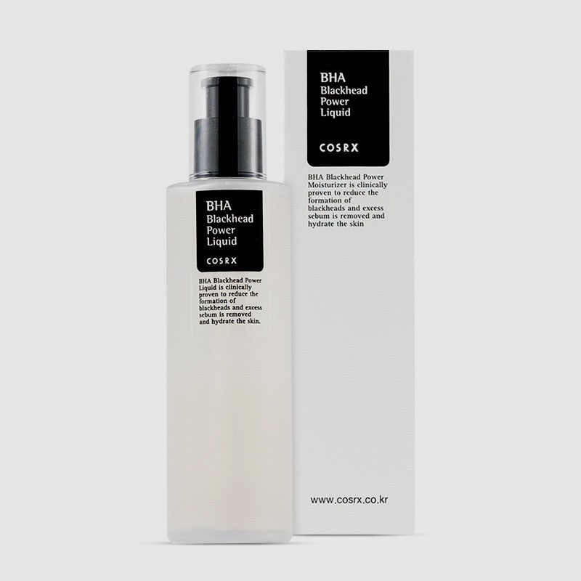
Products with most organic social media mileage
AHA/BHA Clarifying Toner
Low pH Good Morning Gel Cleanser
BHA Blackhead Power Liquid
AHA 7 Whitehead Liquid
Acne Pimple Master Patch
Clear Fit Master Patch
Advanced Snail 96 Mucin Power Essence
One Step Pimple Clear Pads
BHA Skin Returning A-sol
Galactomyces 95 Whitening Power

Slide 21
Additional key words
Negative: | Postive:
Tedious / trouble / lazy / bother / tired | Gentle
Harsh | Spotless
Distracting | Miracles / magic / wonder
Disturbed | Glow
Delusional | Easy
Ugh | Reasonably / affordable / cheaper
Stench | Rich
Pain | Love
Bs | Works
Fake | Supple
Burning | Refreshing
Pricey | Bright
Problematic | Calming
 | Nourishing
 | Protect
 | Smooth
 | Free

Slide 22

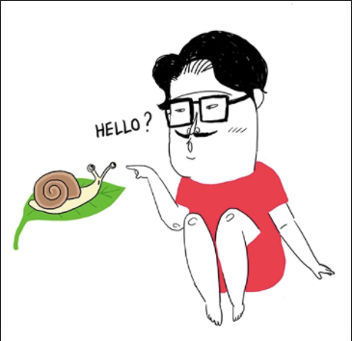
conclusions/recommendations
Keep an eye on developments by top competing brands, particularly The Ordinary, Hada Labo, and Paula’s Choice.
Hada Labo is mentioned for its cleansers, while The Ordinary and Paula’s Choice are mentioned in discussions about brightening.

Slide 23

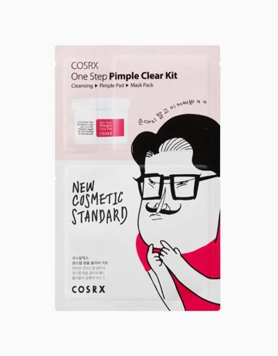
conclusions/recommendations
Pimples are the most common skincare concerns, followed by scars.
8 out of the 10 top COSRX products are geared towards clearing up acne and blemishes.
Hydration comes up in the discussion, but not as often as pimples and scars.
Keep this in mind for product development and social media marketing.

Slide 24

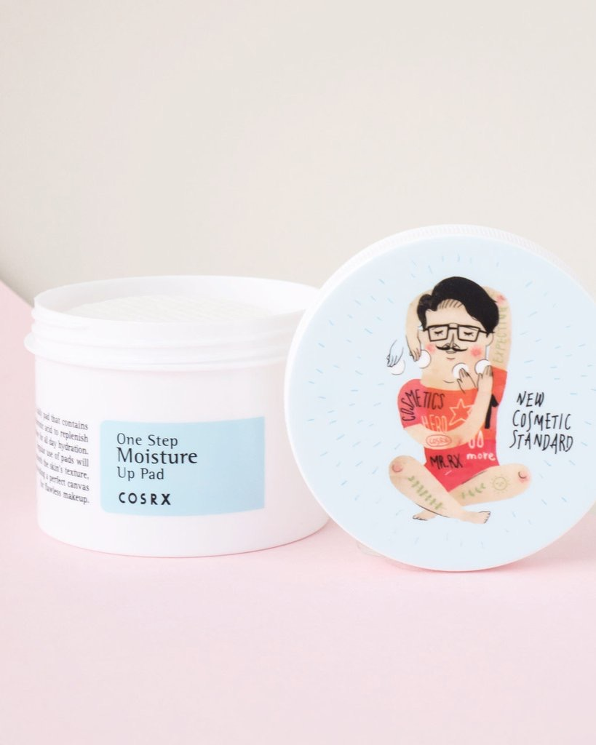
conclusions/recommendations
Convenience is key.
Customers don’t like products that are tedious or too much trouble.
The feel of products when applied also matters (e.g. gentleness vs. harshness, refreshing, calming)

Slide 25

Thank you!

